Slide 1

Analytics strategy for Google Merchandise store
by
Nikhita Gaddam

Slide 2

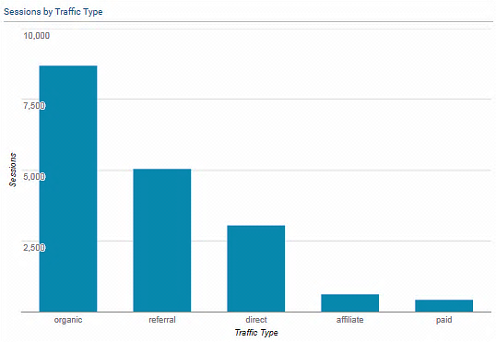
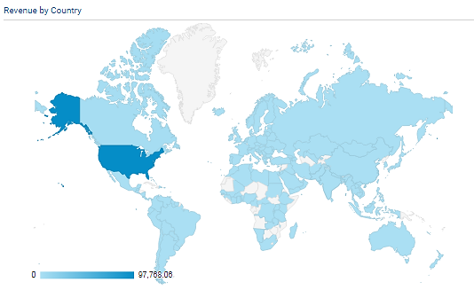
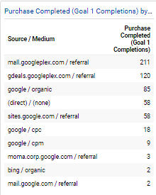
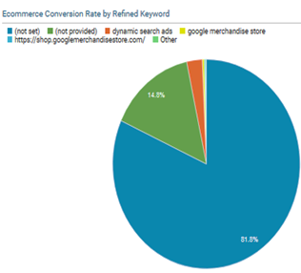
Executive summary
Analysis area – Acquisition channels
Recommendations – The channel traffic data can be used to plan actions to revert the trend on affected channels.
Analysis area – Goal completions by source
Recommendations – Introducing more payment methods and free shipping can help in reducing abandonment at different pages on the site and increase goal completions.
Analysis area – Revenue by geographical location
Recommendations – Appropriate promotional strategies can be implemented to boost conversions in the high revenue generating geographical areas.
Analysis area – Ecommerce conversion by Keyword
Recommendations - Keywords with high ecommerce conversion can be used to give most appropriate product suggestions, restocking etc.

Slide 3
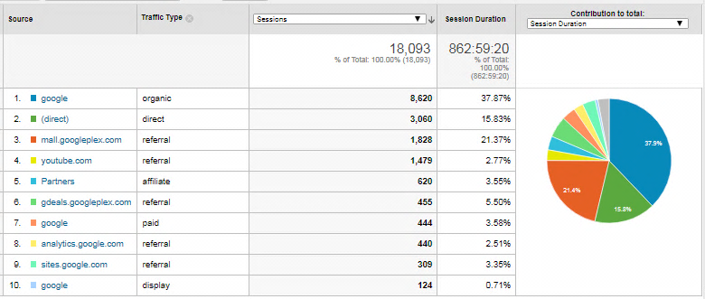
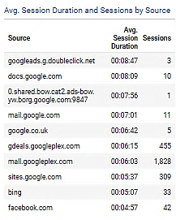

Business Question 1 Which Acquisition channels indicate most time spent on the website? Acquisition and Engagement dashboard
Analysis - The number of sessions and the average session durations are high for organic traffic followed by referral traffic and direct traffic. Top sources for traffic include organic traffic from Google, and referral traffic from mail.googleplex.com and YouTube.
The channels for the most time spent include gdeals.googleplex.com and mail.googleplex.com.

Slide 4
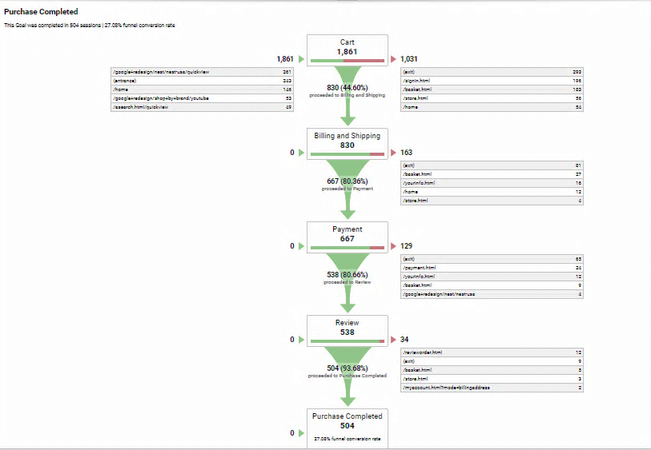
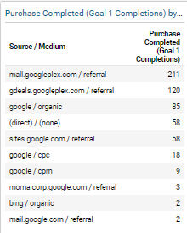
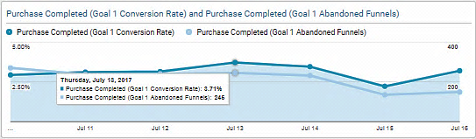
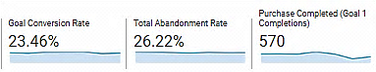
Business Question 2 Which traffic sources show good conversion rates for 'completed purchases'? Goal conversions dashboard
Analysis - The funnel visualization shows the number of goal completions (Purchase completed) and the number of abandonments step by step. The traffic sources for a number of completed purchases are mall.googleplex.com
and gdeals.googleplex.com.

Slide 5
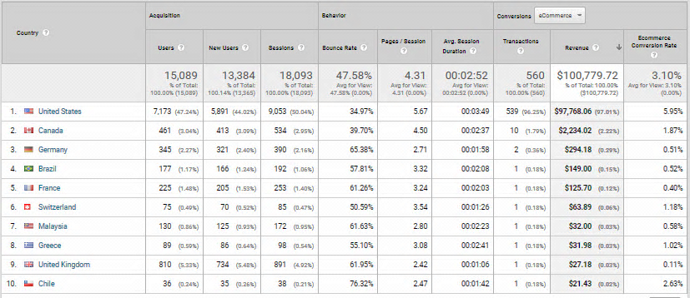
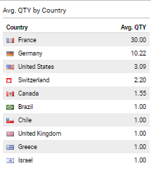
Business Question 3 Which countries have the customers generating most revenue? Ecommerce Revenue dashboard
Analysis - Revenue and the average quantity by Country can be observed in the above dashboard.
The United States and Canada stand out as the high revenue generating countries for the Google Merchandise Store.

Slide 6
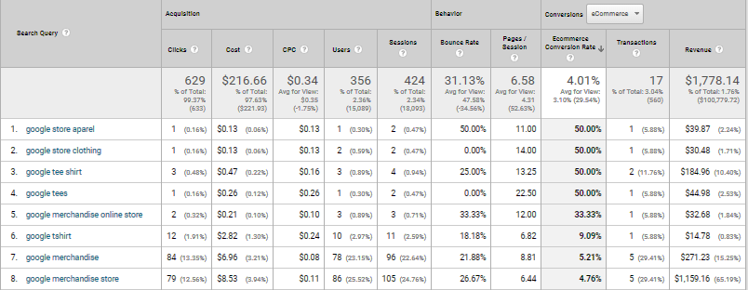
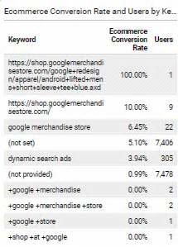
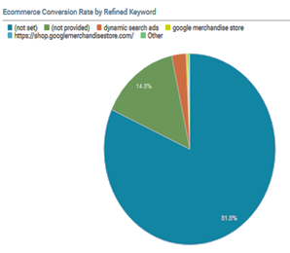
Business Question 4 Which organic keywords drive high ecommerce conversion rate? Ecommerce conversions dashboard
Analysis - The keywords driving high ecommerce conversion rates are Google store aparel, Google store clothing, Google tee shirt and Google tees. Based on this information we can further analyze which areas of the store are attracting customers and develop the store products and pages accordingly.

Slide 7
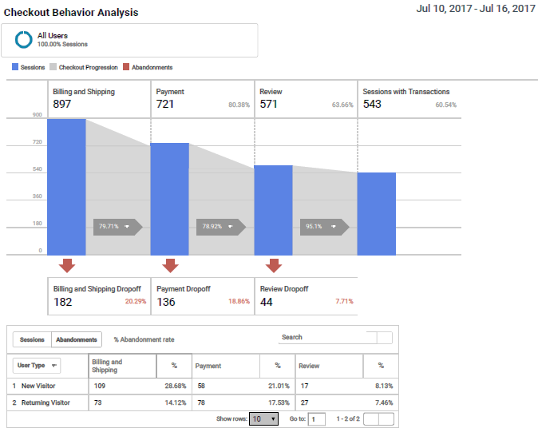



Analysis – These billing and shipping dropoffs can be due to high shipping charges whereas the payment dropoffs can be due to insufficient payment methods. Improving on both these areas can reduce abandonments on these pages.

Slide 8

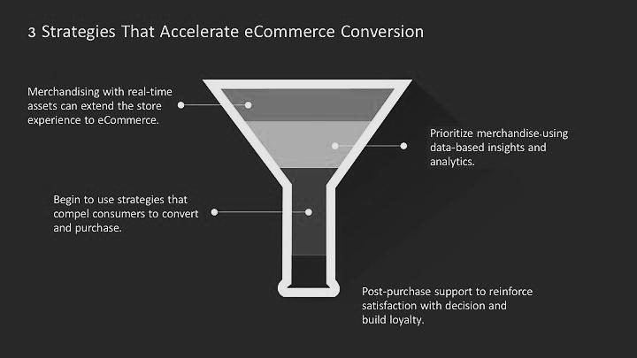


Suggestions
The challenge is to begin to graduate consumers through the funnel.
Understanding what’s important to consumers can be a good foundation for developing and channeling the power of loyalty programs and engaged communities. As we have the geographical data and the referral data regarding the revenue generating customers, using the promotional strategies in those areas can boost conversions.

Slide 9

Thank you

